Slide 1
ggvis package
presented by Naiyan Xu
Ran Bi
Xinyue Liu

Slide 2

Brief introduction
goal: aim at data visualization,make it easy to build interactive graphics for exploratory data analysis
similar to: ggplot2(the grammar of graphics)
BUT, different expression, new features(make plots interactive)
incorporates: shiny’s reactive programming model and dplyr’s grammar of data transformation

Slide 3

pros and cons
pros: ggvis produces fundamentally web graphics, works very differently from the traditional R graphics. This allows us to implement new features like interactivity (exciting!!)
cons: The above feature comes at a cost

Slide 4
pros and cons
For example, every interactive ggvis plot must be connected must be connected to a running R session (static plots do not need a running R session to be viewed).
However, this is great for exploration, because you can do anything in your interactive plot you can do in R, but it’s not so great for publication.

Slide 5
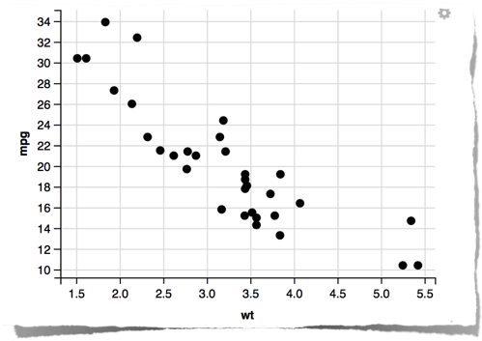
let’s start coding
ggvis()
Every ggvis graphics start with ggvis(). The first argument is the data set that you want to plot, and the other arguments describe how to map variables to visual properties.
p<-ggvis (mtcars,x=~wt, y=~mpg)
this doesn’t plot anything. To display data, you do that by layering visual elements,
layer_points()

Slide 6

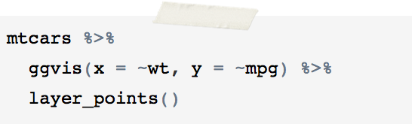
or you can do
the resulting graph is the same
to make life easier, we can use %>%(pipe) from magrittr package

Slide 7
visual properties

Slide 8


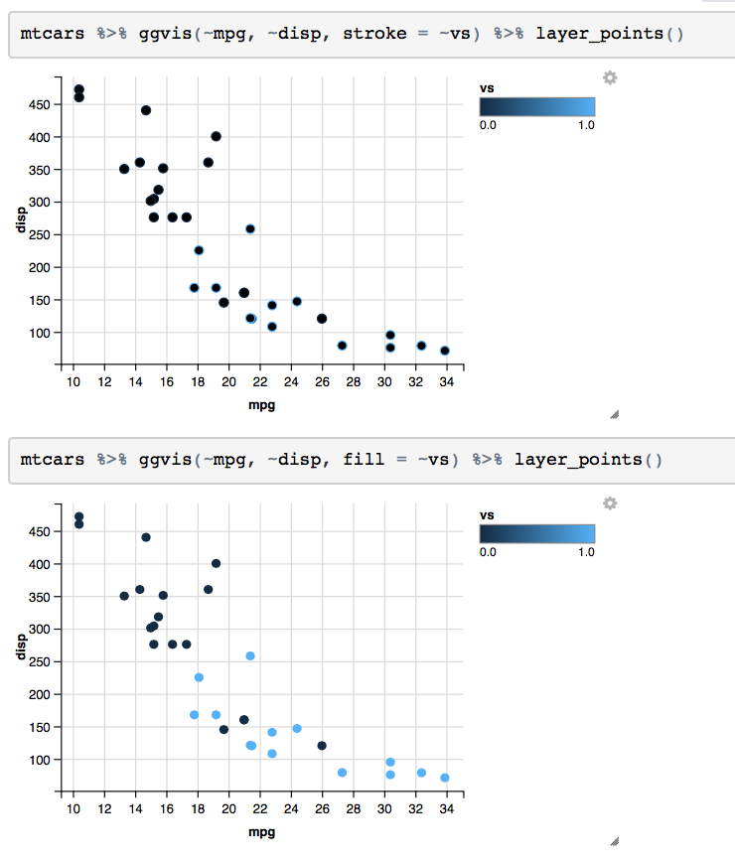
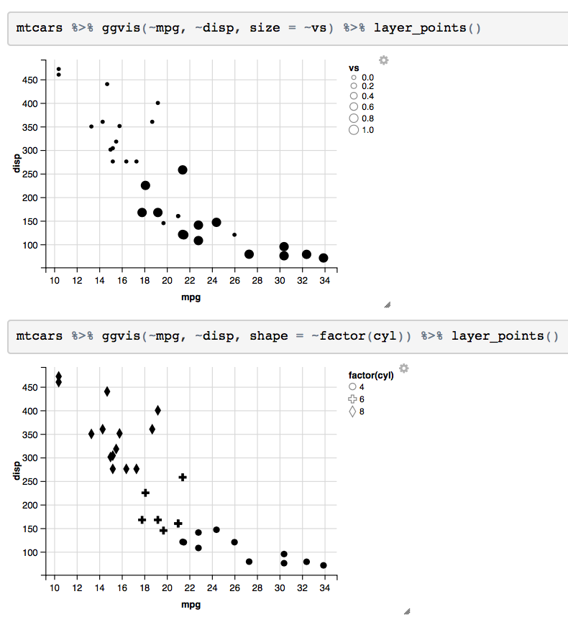

Slide 9
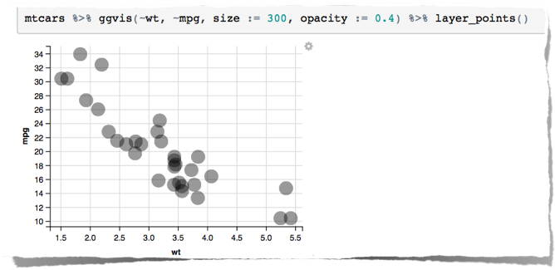
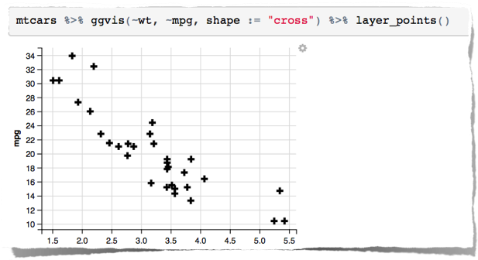
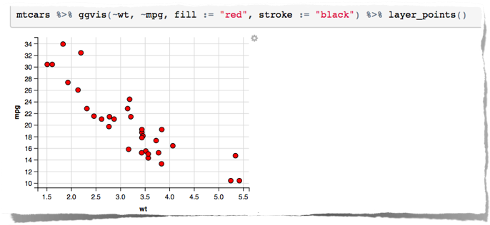

Slide 10
Interaction

Slide 11
What is reactive programming?
In “regular” programming, function calls happen once. The function takes in a value and returns a value.
• In functional reactive programming, a reactive can use a value from another reactive; this creates a dependency graph of reactives. The reactives persist.

Slide 12

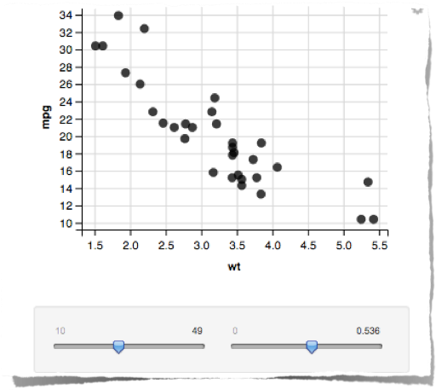
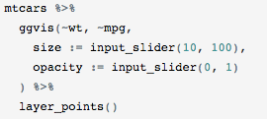

This example allows us to control the size and opacity of points with two sliders:
Reactive computation
parameter:
input_slider

Slide 13

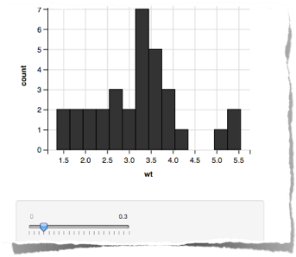

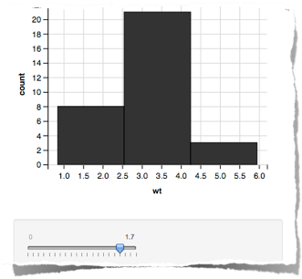
We can also connect interactive components to other plot parameters like the width and centers of histogram bins.

Slide 14
Layers

Slide 15
All layer functions use the plural, not the singular. Think the verb, not the noun: I’m going to layer some points onto my plot.
So far, we seen two layer functions: layer_points() and layer_histograms(). There are many other layers, and they can be roughly categorized into two types:
Simple, which include primitives like points, lines and rectangles.
Compound, which combine data transformations with one or more simple layers.

Slide 16
Simple layers

Slide 17
There are five simple layers:
Points: layer_points()
Paths and polygons: layer_paths()
Filled areas: layer_ribbons()
Rectangles: layer_rects()
Text: layer_text()

Slide 18

The text layer has many new options to control the appearance of the text: text (the label),
dx and dy (margin in pixels between text and anchor point),
angle (rotate the text),
font (font name),
fontSize (size in pixels),
fontWeight (e.g. bold or normal), fontStyle (e.g. italic or normal.)
…

Slide 19


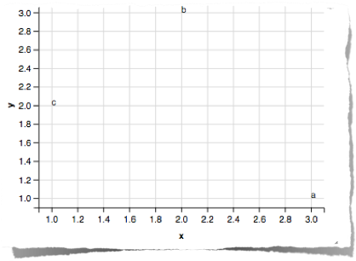


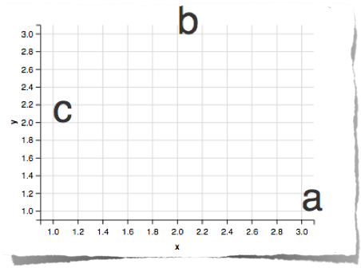

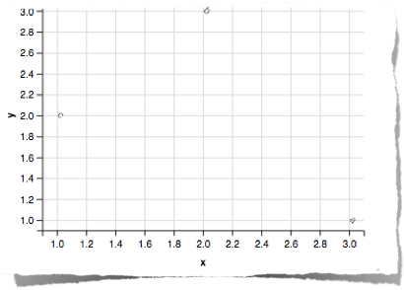

change size!
rotation!

Slide 20
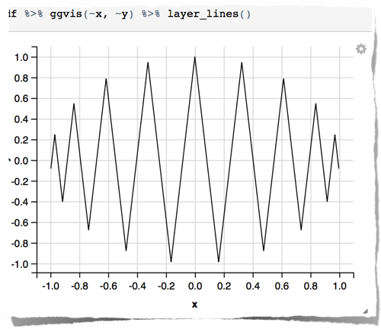
Compound Layers
layer_lines( )
automatically orders by x variable
sort the data on the x variable, so the line will always proceed from left to right

Slide 21
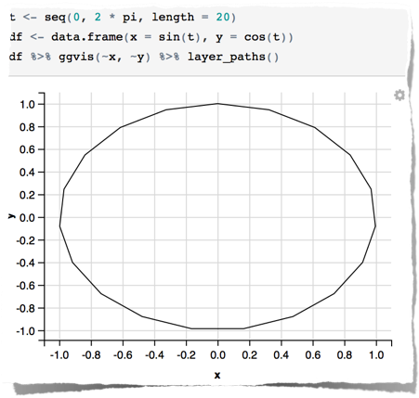
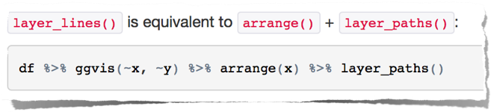
differ from layer_paths( )
draw a line in whatever order appears in the data
completes the subsetting, transforming and ordering in a similar way to subset and transform

Slide 22

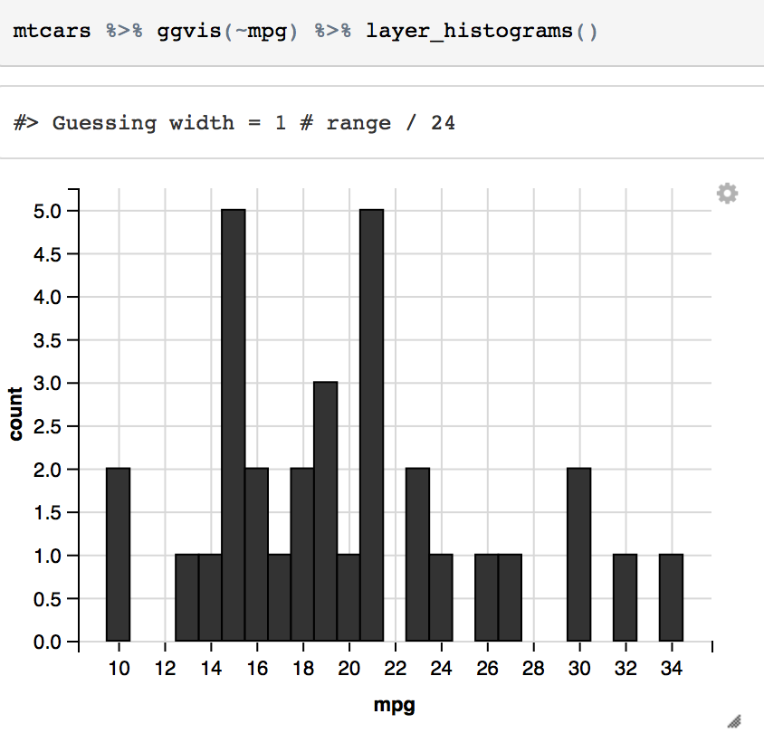
layer_freqpolys( ) layer_histograms( )
allow you to explore the distribution of continuous

Slide 23
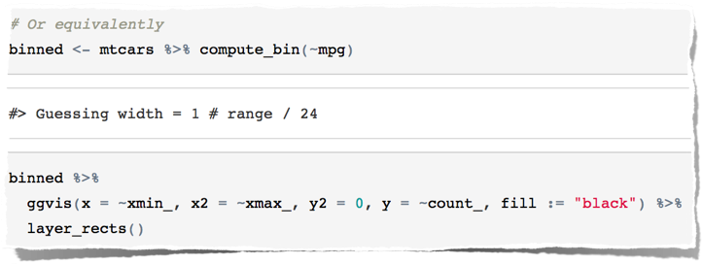
Both layers first bin the data with compute_bin( )
then display the results with either rects or lines.
Same Plot!

Slide 24
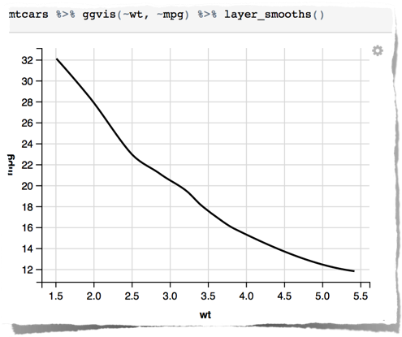
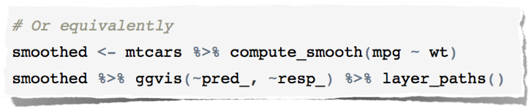
layer_smooths( )
fits a smooth model to the data
displays predictions with a line
used to highlight the trend in noisy data

Slide 25
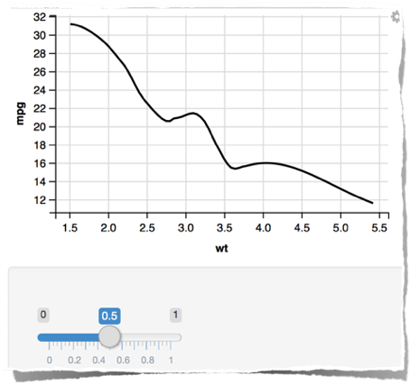
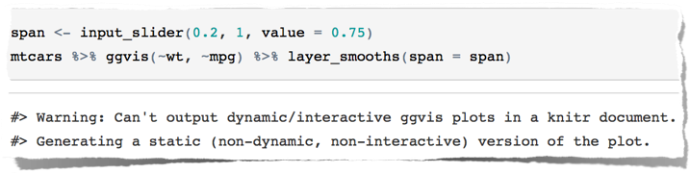
control the degree of wiggliness with the span parameter
Cannot be negative, will remain the same >= 1
The larger the span is, the smoother the line is

Slide 26
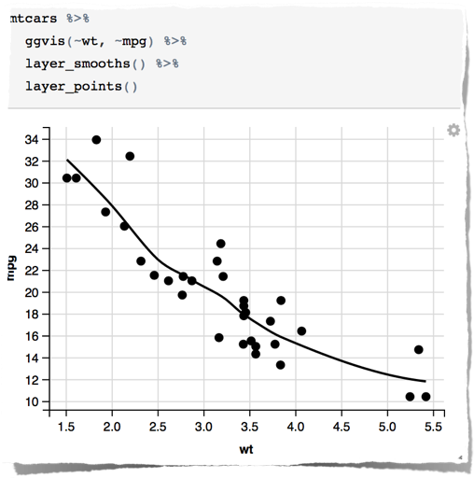
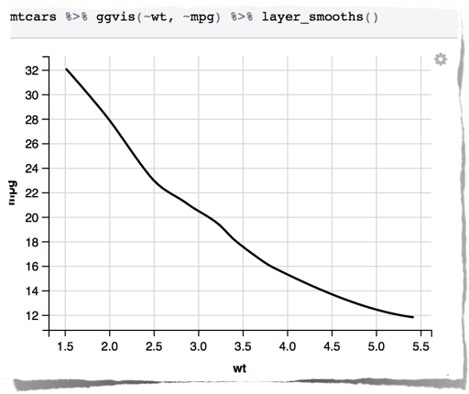
Multiple Layers
combine multiple layers on the same plot to create complex graphics
layer on multiple elements

Slide 27

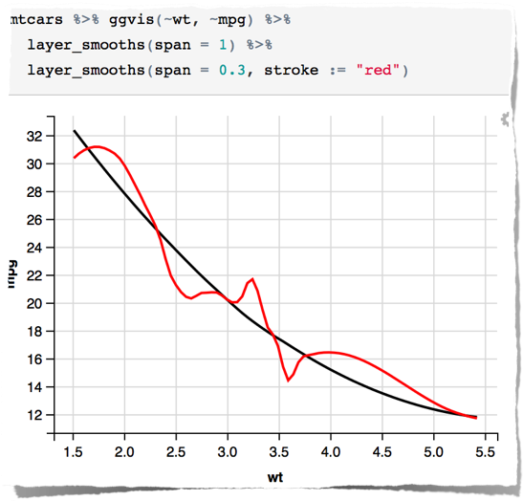
add two smoothers with varying degrees of wiggliness

